Slide 1
Early Oceanography
and the Slave Trade
Contributors: John Wesley Wiggins, Tamara Pico
Keywords: oceanography, surface currents, slavery, slave trade, U.S. Civil War, Atlantic Ocean, scientific racism
Location: Atlantic ocean, global
People: Matthew Fontaine Maury
Last updated: December 6, 2020
Visit https://geo-context.github.io for the teacher’s companion guide to these slides.

Slide 2
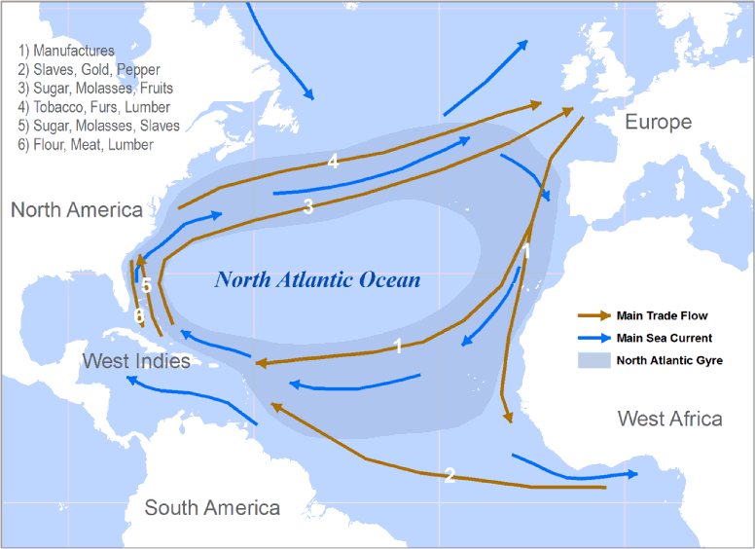
Early Oceanography and the Slave Trade
The North Atlantic Gyre coincides with
the Atlantic Trade Triangle
Modern oceanography developed as a discipline in the 19th century with ocean depth sounding and charting of surface currents
Understanding of surface currents and trade winds motivated by improving commercial trade ship navigation
Between 1810 and 1860, ships transported 3.5 million enslaved people across the Atlantic
north east trade winds
slave ships
Enlightenment Commerce
Notes:
The discipline of oceanography developed in the 19th century, with ocean depth sounding and charting of surface currents. This work was largely motivated by improving commercial ship navigation, including slave ships that carried enslaved people to the United States. Over the same time period that oceanography was developing as a discipline, millions of enslaved people traveled across the Atlantic in slave ships. This figure shows how trade routes in the Atlantic line up closely with the North Atlantic Gyre.

Slide 3
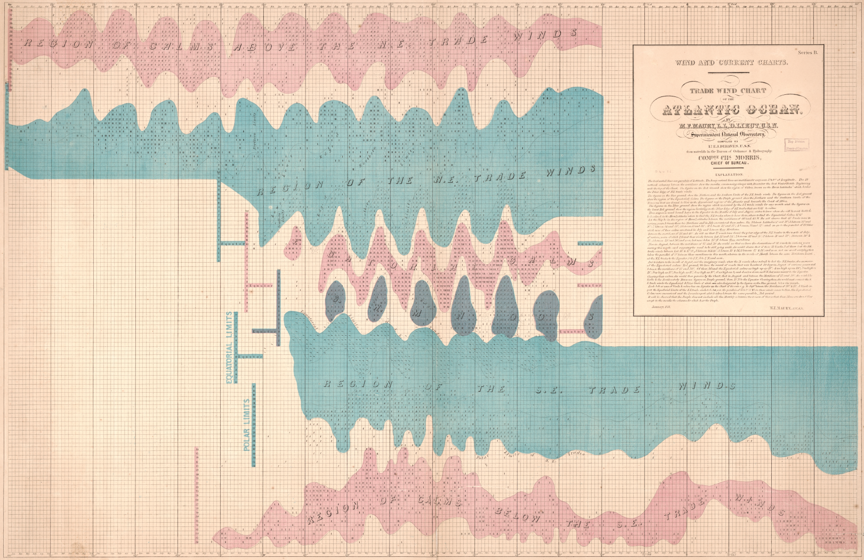
Maury as a key early oceanographer
Matthew Fontaine Maury known as the “Scientist of the Seas” for contributions to ocean navigation — improved commercial routes using collected data on surface currents and winds
Published the first textbook for modern oceanography in 1855: The Physical Geography of the Sea
Professor at the Virginia Military Institute until death in 1873, former U.S. navy officer
Work spans oceanography, meteorology, astronomy, and geology
“Trade wind chart of the Atlantic Ocean,” by Matthew Fontaine Maury, 1851. Geography and Map Division, Library of Congress.
Notes:
One key early oceanographer, Matthew Fontaine Maury, worked on improving commercial routes by collecting data on surface currents and winds. He published the first modern oceanography textbook in 1855, and was a professor at the Virginia Military Institute until his death. His work spanned oceanography, meteorology, astronomy, and geology.
Image from https://blogs.loc.gov/maps/2018/07/scientist-of-the-seas-the-legacy-of-matthew-fontaine-maury/
https://www.history.navy.mil/content/history/nhhc/research/library/online-reading-room/title-list-alphabetically/m/matthew-fontaine-maury-benefactor-of-mankind.html

Slide 4
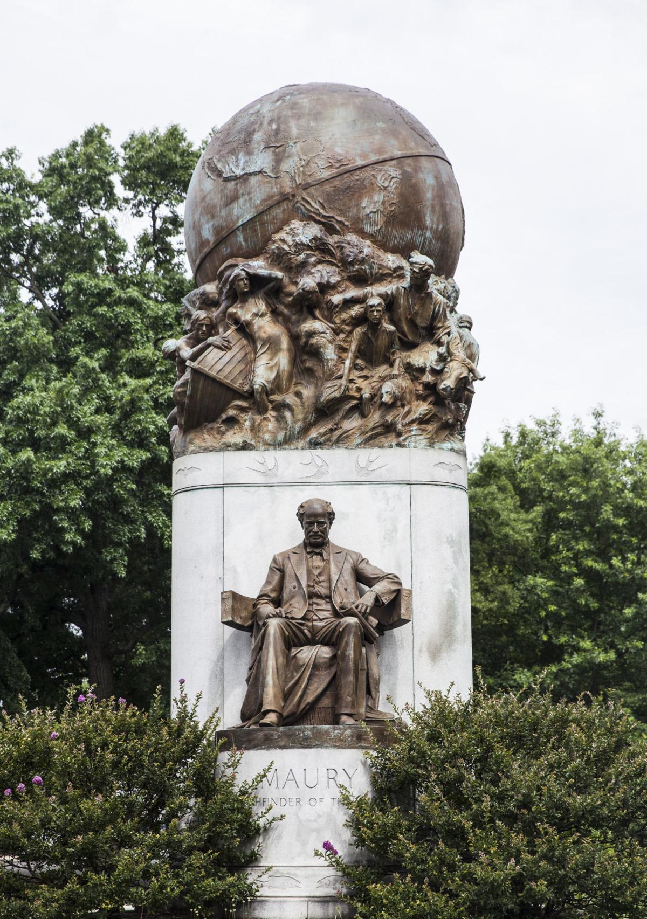
Maury and the Confederate States of America
Served in Confederate Navy, for home state of Virginia
During Civil War he pushed European powers to support the Confederate cause
Prior to Civil War proponent of the idea of moving slaves out of the United States and into Brazil, like other proslavery politicians
Maury’s statue in Richmond, Virginia was removed in July of 2020
Left: Statue of Matthew Fontaine Maury in Richmond, Virginia. Daniel Sangjib Min/Times-Dispatch
Notes:
During the U.S. Civil War, Maury served in the Confederate Navy and worked hard to convince European governments to support the Confederate side. Before the Civil War, Maury, similar to other proslavery politicians at this time, saw the demise of slavery in the U.S., and advocated instead for U.S. slave owners to own land in Brazil, and continue forced slave labor in South America.
Maury’s strong Confederate legacy inspired a statue in Richmond, Virginia on Monument Avenue, and was removed in July 2020, in light of his racist legacy advocating for the continuation of slavery.
https://blogs.loc.gov/maps/2018/07/scientist-of-the-seas-the-legacy-of-matthew-fontaine-maury/
Image: Statue of Matther Fontain Maury in Richmond Virginia → https://richmond.com/discover-richmond/outdoor-curiosities-matthew-fontaine-maury-statue/article_d6ce4294-06fa-5771-aae4-2f87ddac584d.html

Slide 5
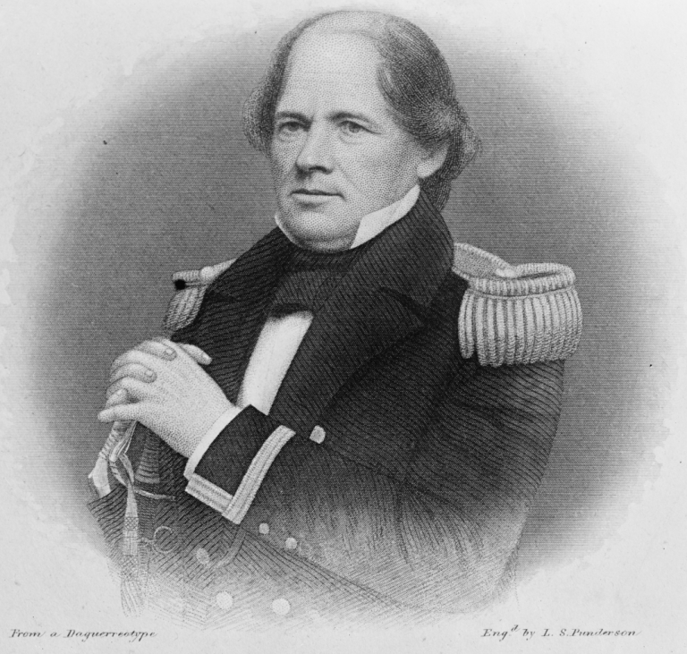
Arguing for continuation of U.S. slavery in Brazil
“The Amazonian Republic”: Maury argued slaveholders should own property in Brazil, which he considered, like the United States, to be a “slave country” based on climatic & geographic similarity of Mississippi to Amazon
Ocean currents and winds flowed easily between United States South and Brazil, enabling connection
Plan was to forcibly migrate slaves to Brazil and continue producing American agricultural products
At Maury’s suggestion, United States Navy conducted navigability tests of the Amazon River
“Maury’s research cannot be separated from his larger vision in the 1840s and 1850s of a seaborn commercial empire linking the United States, the Caribbean Sea, and the Amazon basin in Brazil. What tied this “Amazonian Republic” - as Maury called it - together? Ocean currents, certainly. But also slavery.”
- Chris Graham, American Civil War Museum
“MAURY, MATTHEW FONTAINE, U.S.N.” 1917. Harris & Ewing Collection, Prints and Photographs Division, Library of Congress.
Notes:
Maury termed his vision for the continuation of U.S. slavery in Brazil “The Amazonian Republic”. He proposed that U.S. slaveholders would own property in Brazil, which he considered, like the U.S. to be a slave country based on the similar climate and geography of the Amazon to the Mississippi River. Like other scientists of this time (See Landscape Slides), Maury believed that certain climates or topographies were well-suited for the instituion of slavery. Based on the pattern of ocean surface currents, Maury argued that Brazil was a natural extension of the U.S. empire as surface currents would hasten travel between the southern U.S. and Brazil and Carribean. Maury envisioned a continuation of agricultural production by U.S. owned slaves. The plausibility of this “Amazonian Republic” was tested by U.S. Navy by exploring the navigability of the Amazon River, at Maury’s suggestion.
Source of Quote: https://acwm.org/blog/what-did-matthew-fontaine-maury-ever-do-to-deserve-his-removal-from-monument-avenue/
https://blogs.loc.gov/maps/2018/07/scientist-of-the-seas-the-legacy-of-matthew-fontaine-maury/

Slide 6
Sources
https://acwm.org/blog/what-did-matthew-fontaine-maury-ever-do-to-deserve-his-removal-from-monument-avenue/
https://blogs.loc.gov/maps/2018/07/scientist-of-the-seas-the-legacy-of-matthew-fontaine-maury/
https://www.history.navy.mil/content/history/nhhc/research/library/online-reading-room/title-list-alphabetically/m/matthew-fontaine-maury-benefactor-of-mankind.html
https://enlightenmentcommerce.wordpress.com/category/uncategorized/

